Slide 1
An Introduction to Integrated Marketing Communications

Slide 2
Definition of Integrated Marketing Communications
A concept of marketing communications planning that recognizes the added value of a comprehensive plan that evaluates the strategic roles of a variety of communication disciplines and combines these disciplines to provide
clarity,
consistency and maximum communications impact.

Slide 3
Integrated Marketing Communications
A marketing communications planning concept that recognizes the value of a comprehensive plan.
A plan that evaluates the strategic roles of several communications disciplines:
Media advertising
Direct marketing
Interactive/internet marketing
Sales promotion
Publicity/Public relations
Combines the disciplines to provide:
Clarity
Consistency
Maximum communications impact

Slide 4
The Marketing & Promotional Mixes
Marketing Mix:
Product or Service
Pricing
Channels of Distribution
Promotion
Promotional Mix:
Advertising
Direct Marketing
Interactive/internet marketing
Sales Promotion
Publicity/Public Relations
Personal Selling

Slide 5
Reasons For Growing Importance of IMC
Shift from media advertising to other forms of marketing communication
Movement away from advertising focused- approaches that emphasize mass media
Shift in power from manufacturers to retailers Rapid growth of database marketing Demands for greater ad agency accountability Changes in agency compensation
Rapid growth of the Internet Increasing importance of branding

Slide 6
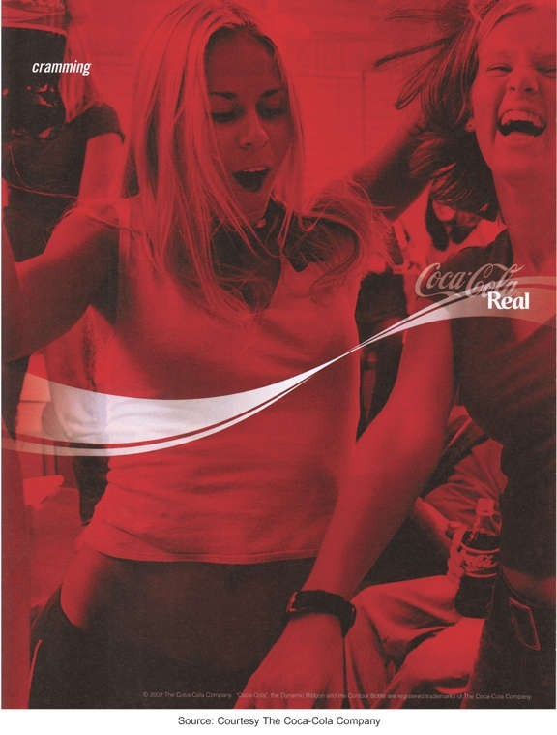
Coca-Cola is one of the most valuable brands

Slide 7
IMC Communication Tools
IMC Communication Tools
Advertising |  |  | Direct Marketing
Interactive/
Internet Marketing
Sales
Promotion
Publicity/Public Relations
Personal
Selling

Slide 8
Advertising
Any paid form of nonpersonal communication about an organization, product, service, idea or cause by an identified sponsor.
Disadvantages of advertising
– High costs of producing and running ads
– Credibility problems and consumer skepticism
– Clutter
– Difficulty in determining effectiveness
Advantages of advertising
– Advertiser controls the message
– Cost effective way to communicate with large audiences
– Effective way to create brand images and symbolic appeals
– Often can be effective way to strike responsive chord with consumers

Slide 9
Classifications of Advertising
Advertising to Consumer Markets
National advertising Retail/local advertising Advertising to increase demand
– Primary demand for the product category
– Selective demand for a specific brand
Business & professional advertising
Business-to-business advertising
Professional advertising
Trade advertising

Slide 10

An example of a business-to-business ad
Source: Courtesy Honeywell.

Slide 11
Direct Marketing
A system of marketing by which organizations communicate directly with target customers to generate a response and/or a transaction.
Disadvantages of direct marketing Lack of customer receptivity and
very low response rates
Clutter (too many messages)
Image problems – particularly with telemarketing
Advantages of direct marketing Changes in society have made
consumers more receptive to
direct-marketing
Allows marketers to be very selective and target specific segments of customers
Messages can be customized for specific customers.
Effectiveness easier to measure

Slide 12
Direct Marketing
Direct marketing methods
–Direct mail
–Catalogs
–Telemarketing
–Direct response ads
–Direct selling
–Internet

Slide 13
Interactive/Internet Marketing
A form of marketing communication through interactive media which allow for a two-way flow of information whereby users can participate in and modify the content of the information they receive in real time.
Advantages of interactive/ Disadvantages of interactive/
internet marketing
Can be used for a variety of IMC functions
Messages can be tailored to specific interests and needs of customers
Interactive nature of the Internet leads to higher level of involvement
Can provide large amounts of information to customers.
internet marketing
Internet is not yet a mass medium as many consumers lack access
Attention to Internet ads is very low
Great deal of clutter on the Internet
Audience measurement is a problem on the Internet

Slide 14
Interactive/Internet Marketing
Use of the Internet as an IMC Tool
– As an advertising medium to inform, educate and persuade customers
– As a direct sales tool
– To obtain customer database information
– To communicate and interact with buyers
– To provide customer service and support
– To build and maintain customer relationships
– As a tool for implementing sales promotion
– As a tool for implementing publicity/public relations programs

Slide 15
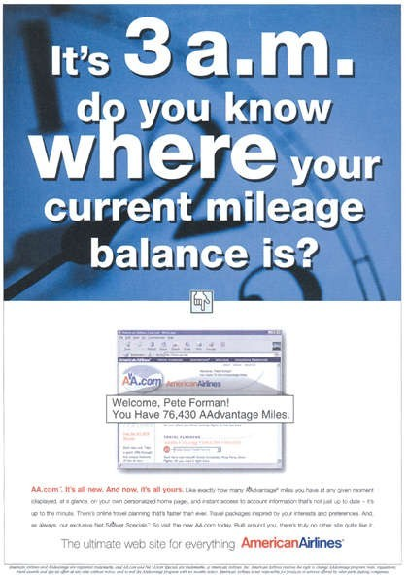
The Internet is an important IMC tool for American Airlines
Source: Courtesy American Airlines.

Slide 16
Sales Promotion
Marketing activities that provide extra value or incentives to the sales force, distributors, or ultimate consumers and can stimulate immediate sales.
Consumer-oriented
– Targeted to the ultimate users of a product or service
Coupons
Sampling
Premiums
Rebates
Contests
Sweepstakes
POP materials
Trade-oriented
Targeted toward marketing intermediaries such as retailers, wholesalers, or distributors
Promotion allowances
Merchandise allowances
Price deals
Sales contests
Trade shows

Slide 17
Sales Promotion Uses
Introduce new products
Get existing customers to buy more Attract new customers
Combat competition
Maintain sales in off season Increase retail inventories
Tie in advertising & personal selling
Enhance personal selling efforts

Slide 18
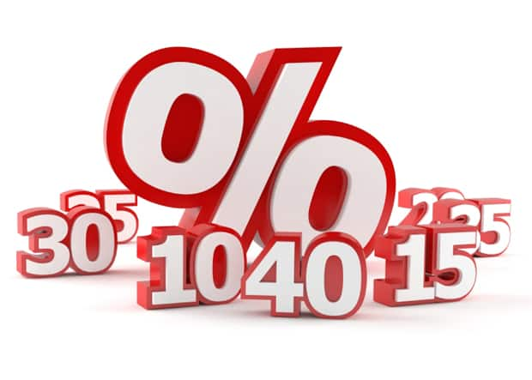
Types of sales promotion
Consumer promotion
Trade promotion
Sales-force promotion

Slide 19
Major Consumer Sales promotion
Coupons
Free samples
Discounts
Buy 1/2/3 get 1/1/5 free
Combo pack
Free Trial
Exchange offer
Contests
Financing
Gifts

Slide 20
Major Trade Sales Promotion
Price Off/ Straight Discount
Allowance (Advertising / Display Allowance)
Free Goods (Free gift/good sor selling in less/Given time)
POP
Push Money(Extra % on selling x amount)
Coupons/Passes
Dealer Competition- ( Ex- the best sales dealer in territory X gets a free print ad in newspaper from the company or he gets free incentives for all his sales people)
Exhibition/Trade shows
Advertising sponserships/Co-operative advertising

Slide 21
Major Sales-Force Promotion
Incentives
Gifts
Bonus/Awards
Meetings/conferences/ Demonstration

Slide 22
Publicity
Nonpersonal communication regarding an
organization, product, service, or idea not directly paid for or run under identified sponsorship.
Advantages of publicity
– Credibility
– Low cost (although not totally free)
– Often results in word-of-mouth
Disadvantages of publicity
– Not always under control of organization
– Can be negative

Slide 23
Publicity Vehicles
News Releases:
Single-page news stories sent to media who might print or broadcast the content.
Feature Articles:
Larger manuscripts composed and edited for a particular medium.
Captioned Photos:
Photographs with content identified and explained below the picture.
Press Conferences:
Meetings and presentations to invited reporters and editors.
Special Events:
Sponsorship of events, teams, or programs of public value.

Slide 24
Advertising Versus Publicity
FACTOR
Control Credibility
Reach Frequency Cost Flexibility Timing
ADVERTISING
Great Lower
Achievable Schedulable Specific High Specifiable
PUBLICITY
Little Higher
Undetermined Undetermined Unspecified/low Low
Tentative

Slide 25
Public Relations
The management function which evaluates public
attitudes, identifies the policies and procedures of an individual or organization with the public interest, and executes a program of action to earn public understanding and acceptance.
Tools used by Public Relations
Publicity
Special publications
Community activity participation
Fund-raising
Special event sponsorship
Public affairs activities

Slide 26
Personal Selling
Direct person-to-person communication whereby a seller attempts to assist and/ or persuade perspective buyers to to purchase a product or service.
Advantages of personal selling Disadvantages of personal selling
Direct contact between buyer and seller allows for more flexibility
Can tailor sales message to specific needs of customers
Allows for more direct and immediate feedback
Sales efforts can be targeted to specific markets and customers who are best prospects.
High costs per contact
Expensive way to reach large audiences
Difficult to have consistent and uniform message delivered to all customers

